Slide 1
Under Sea Modeling Library
Sean Reilly

Slide 2
Literate Programming
Instead of imagining that our main task is to instruct a computer what to do, concentrate on explaining to future developers what we want the computer to do.
Strive for a programming style that is comprehensible because its concepts have been introduced in an order that is best for human understanding.
Integrate SDD and STD document into the source code using Doxygen.
REF: Donald Knuth. "Literate Programming (1984)" in Literate Programming. CSLI, 1992, pg. 99.

Slide 3
Test Driven Development (TDD)
Start the development of each new feature by first designing its unit test.
Every module includes a “test” directory.
Detect and record failures to match analytic results.
Readiness of each new feature defined by the quality of its test.
Boost Test Library Unit Test Framework (UTF) to implement these goals.
Organizes all units tests into a regression suite.
Focus on verification phase of testing.
Prove that software works as designed.
Not that model replicates real-world.
That comes later.

Slide 4
USML Modules
Geodetic Acoustic Rays
Wave Fronts
Eigenray Results
ProplosS Results
acoustics model
NetCDF Files
Fundamental Data Types
Ocean Components
Bathymetry
Ocean Profiles
COARDS, WOA, ETOPO
Data Grids
Sequences
World Coordinates
Profiles
Attenuation
Boundaries
Reflection Loss
uBLAS Extensions
uses
abs, arg, sqrt, max, ...
cos, acos, cosh, acosh, ...
exp, log, pow, ...
modeling framework

Slide 5
uBLAS Extensions
scalar addition: matrix +/- scalar, scalar +/- matrix
division of scalar by matrix
max(), min(), floor(), ceil()
abs(), abs2(), arg(), sqrt(), copysign()
cos(), cosh(), sin(), sinh(), tan(), tanh()
acos(), acosh(), asin(), asinh(), atan(), atan2(), atanh()
exponential functions: exp(), log(), log10(), pow()
generate real and analytic signals
uniform, Gaussian, complex Gaussian random numbers

Slide 6

Fundamental Data Types
Abstract Data Grid
in N Dimensions
World Coordinates
wvector
ρ, θ, φ
Nearest, Linear, PCHIP Interpolation
wposition
latitude
longitude
altitude
sequence 2
data
distance, dot, area, direction, earth radius
sequence 1

Slide 7
NetCDF Files
netcdf_coords
Extracts a data_grid by name from any netCDF file that complies with Cooperative Ocean/Atmosphere Research Data Service (COARDS) standards.
netcdf_bathy
Extracts a 2-D data_grid from a variety of netCDF formats.
Deduces the variables to be loaded based on their dimensionality.
netcdf_profile
Extracts a 3-D data_grid from a variety of netCDF formats.
Deduces the variables to be loaded based on their dimensionality.
netcdf_woa
netcdf_profile that splices shallow and deep World Ocean Atlas (WOA) databases.

Slide 8
Ocean Profiles & Attenuation
attenuation_constant
attenuation_thorp
1
each profile_model
is a kind of
attenuation_model
attenuation_model
each profile_model
includes one
attenuation_model
profile_model
data_grid
profile_linear
profile_munk
profile_grid
profile_n2
profile_catenary
profile_mackenzie
Decorator Design Pattern

Slide 9
Ocean Boundaries & Reflection
reflect_loss_constant
reflect_loss_rayleigh
1
each boundary_model
is a kind of
reflect_loss_model
reflect_loss_model
each boundary_model
includes one
reflect_loss_model
boundary_model
data_grid
boundary_flat
boundary_slope
boundary_grid
Decorator Design Pattern

Slide 10
Ocean Model Container
profile_model
profile
ocean_model
surface
bottom
boundary_model
Combines the effects of surface, bottom,
and profile into a single model.

Slide 11
Geodetic Acoustic Rays Wavefront Processing
ocean_model
wave_front.step()
update
detect reflections
read
read
update
AB3 integrator
next
current
wave_element
circular queue
proploss
targets
read
previous
read
past
detect eigenrays
add
proploss eigenrays

Slide 12
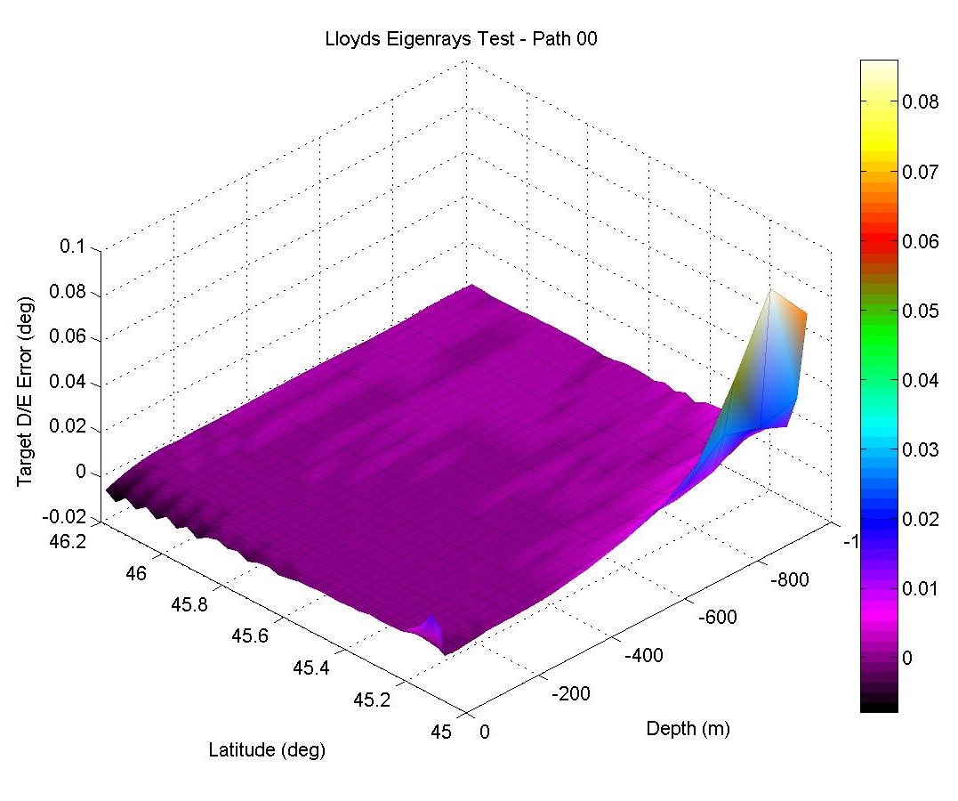
Matlab Testing and Analysis
Write wavefronts, proploss, and eigenrays to disk in netCDF format.
Illustrate and analyze errors in Matlab.

